Slide 1
PIPO 구현 코드 분석
https://youtu.be/Q6R0wn9Dlts

Slide 2
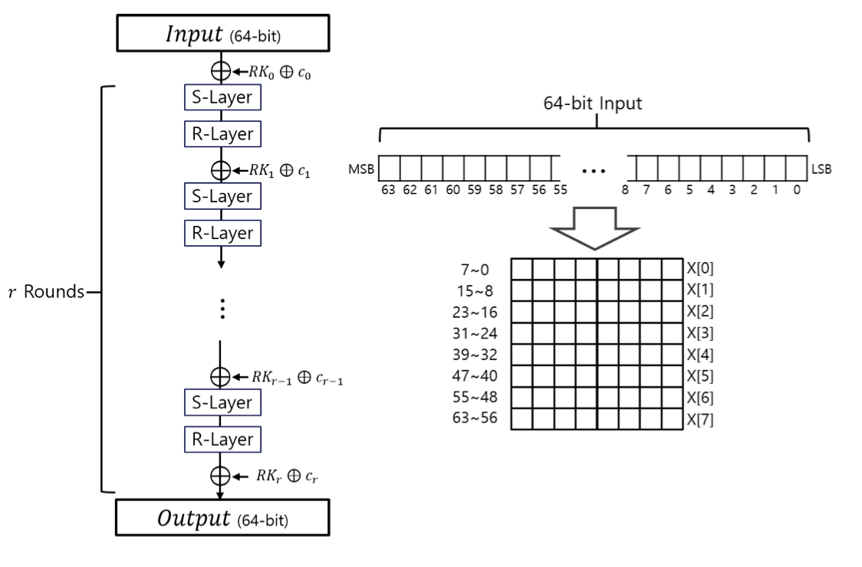
PIPO
PIPO - 64/128 13ROUND
PIPO - 64/256 17ROUND

Slide 3
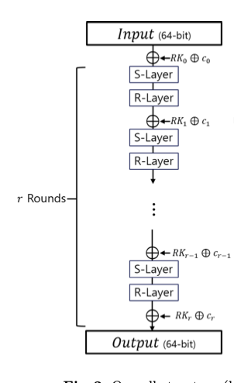
PIPO 라운드키
128-bit Key
64-bit round key
64-bit round key

Slide 4
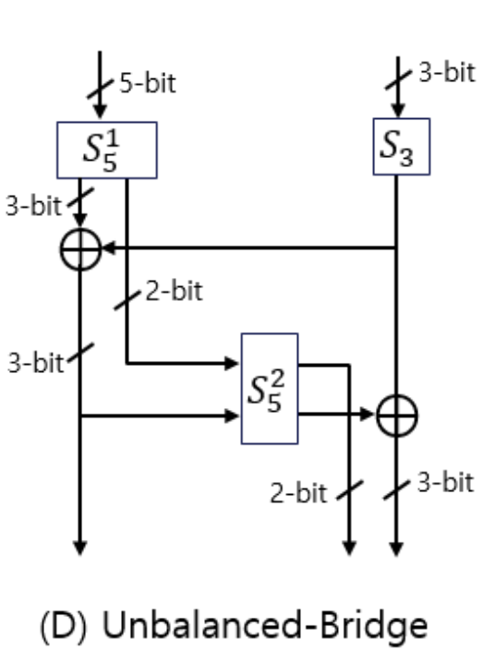
PIPO S-layer

Slide 5
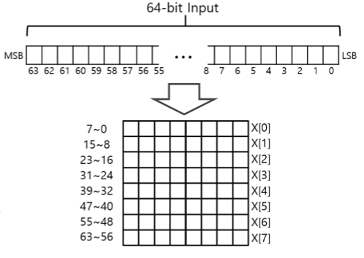
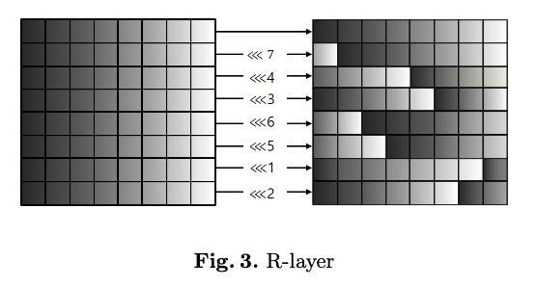
PIPO R-layer

Slide 6
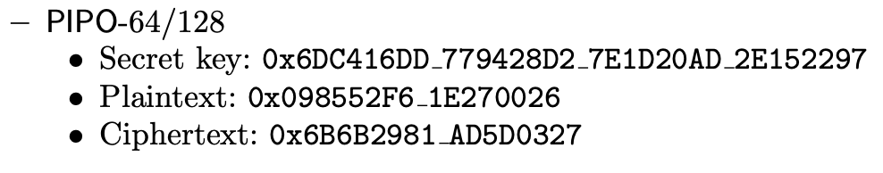
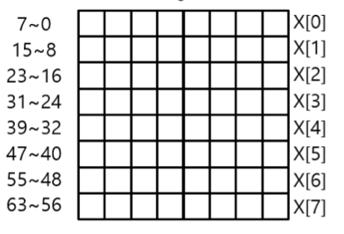
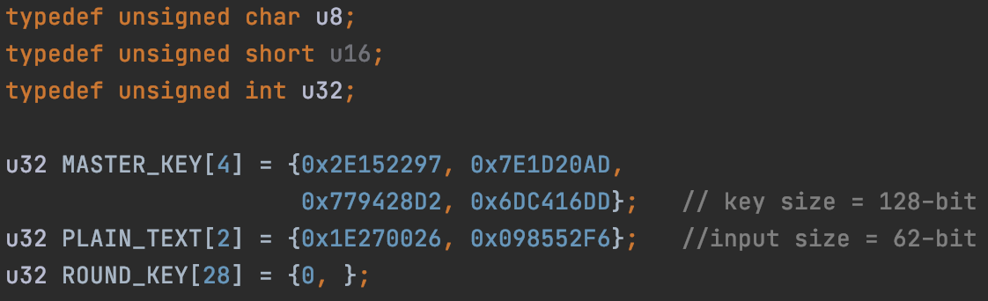
PIPO

Slide 7
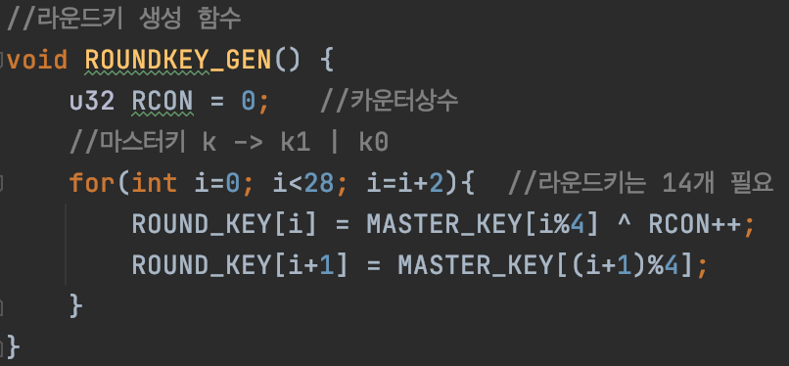
PIPO 라운드키 생성 함수

Slide 8
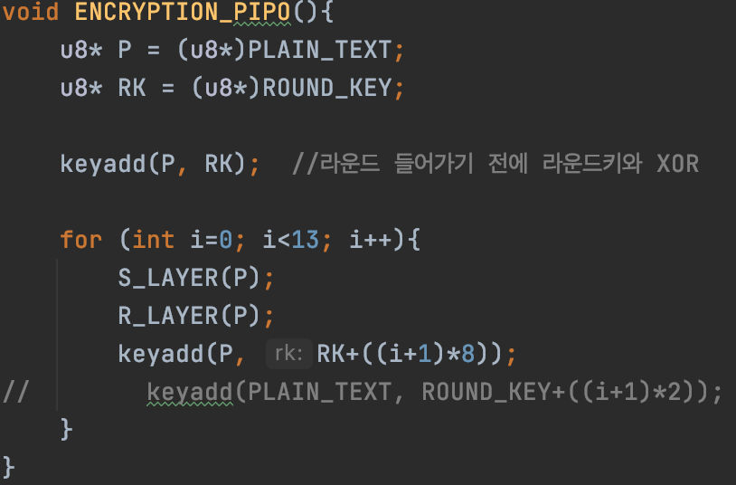
PIPO encryption 함수
#0 | #4
0x12345678 | 0xa1b2c3d4
#0 | #1 | #2 | #3 | #4 | #5 | #6 | #7
0x78 | 0x56 | 0x34 | 0x12 | 0xd4 | 0xc3 | 0xb2 | 0xa1

Slide 9
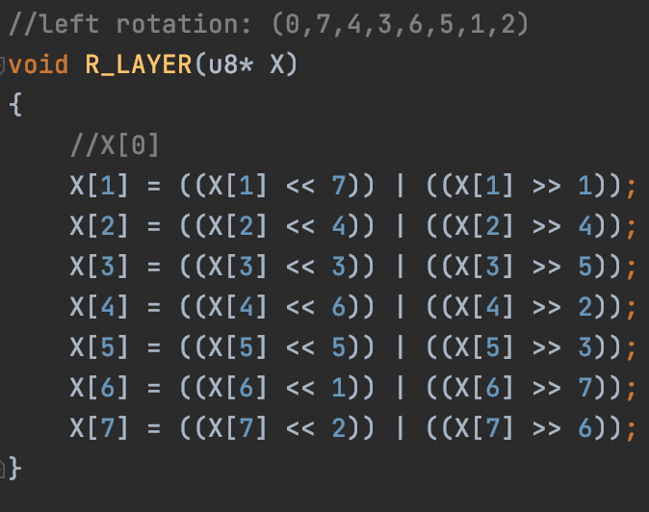
PIPO R-Layer
X[5]
1 | 2 | 3 | 4 | 5 | 6 | 7 | 8
X[5] << 5
6 | 7 | 8 | 0 | 0 | 0 | 0 | 0
X[5] >> 3
0 | 0 | 0 | 1 | 2 | 3 | 4 | 5
OR
6 | 7 | 8 | 1 | 2 | 3 | 4 | 5

Slide 10
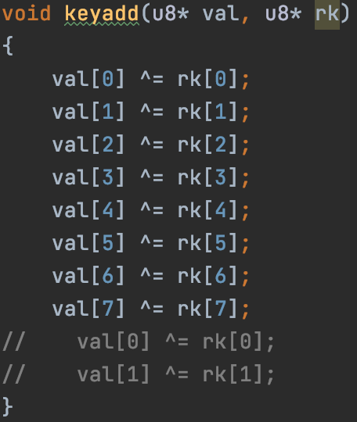
PIPO Keyadd 함수

Slide 11
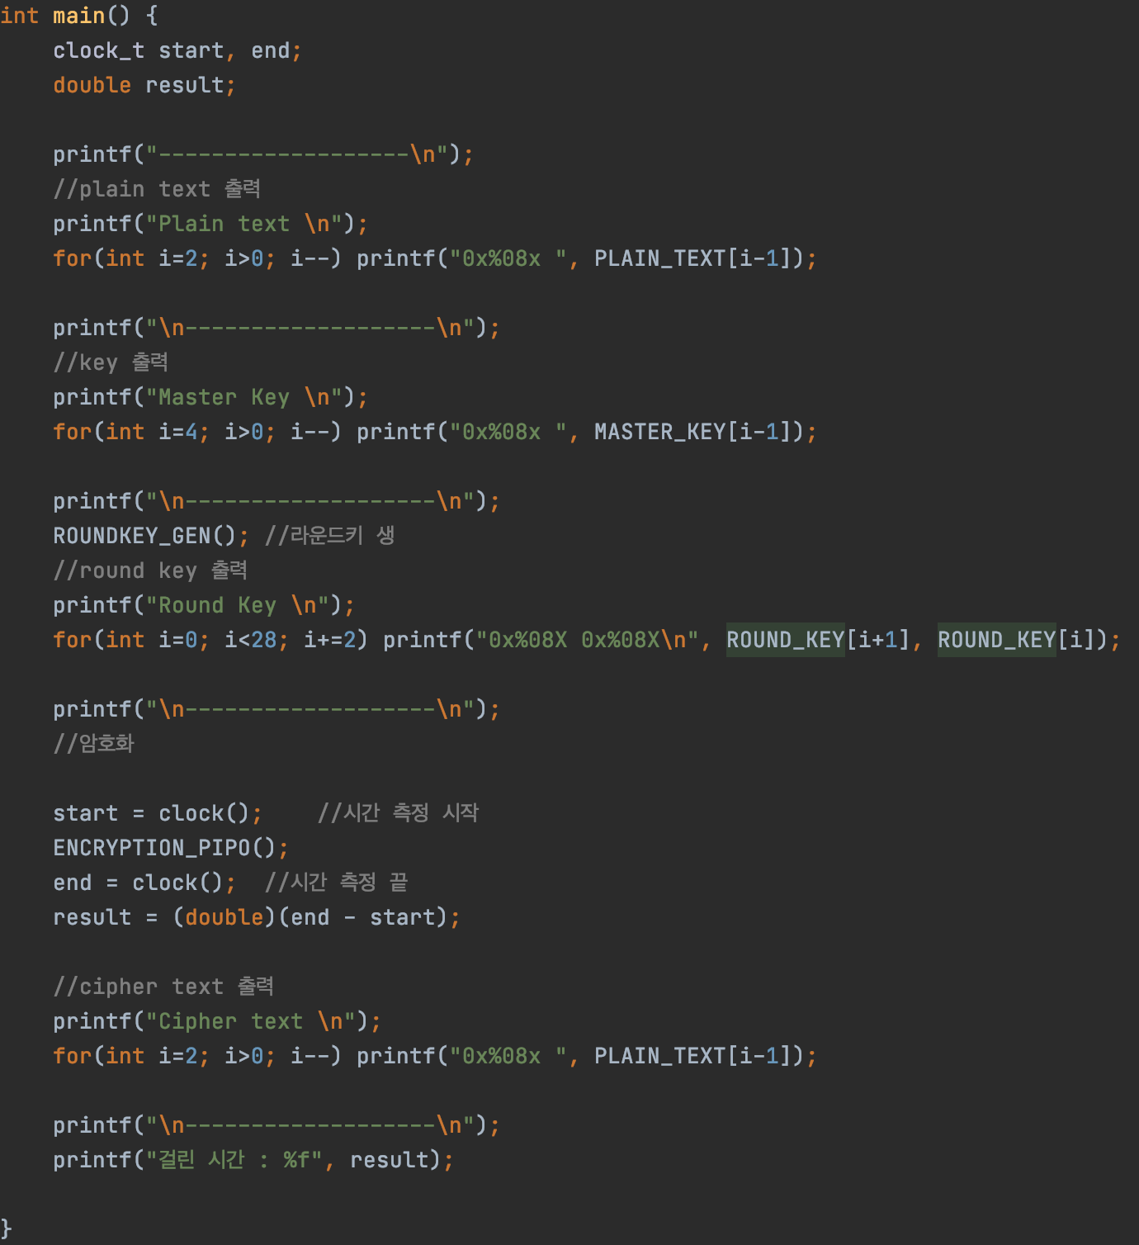
PIPO

